Slide 1
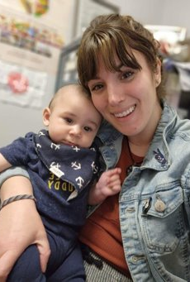
Maggie's place: A resource centre for families association Annual general meeting 2022-23

Slide 2
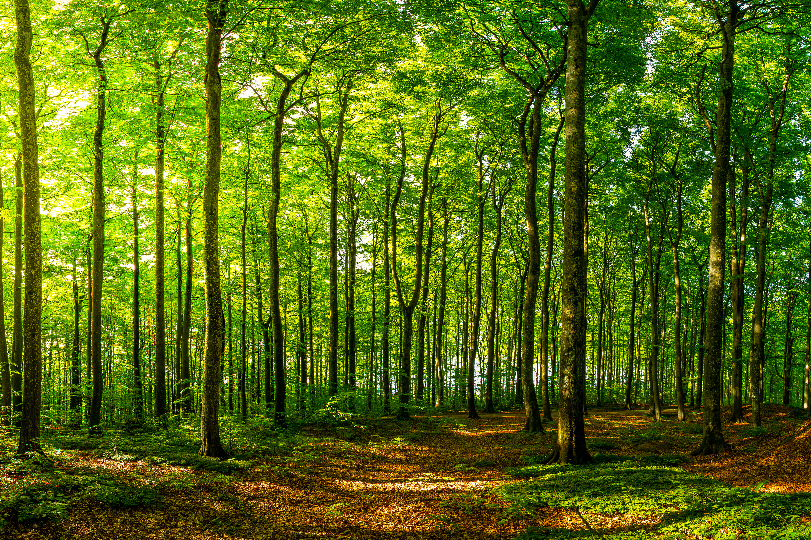
Land Acknowledgement

Slide 3
Agenda
Land Acknowledgement
Approval of Agenda
Approval of Minutes of AGM, June 10, 2022
Highlights from Board Co-Chairs & Executive Directors
Financial Report:
-Auditor’s Report
-Appointment of Auditor for 2023-24
Nominating Committee Report
Special Recognition
Adjournment

Slide 4
BOARD HIGHLIGHTS FOR 2022-23
NEW & AMENDED PERSONNEL POLICIES APPROVED
FULL COMPLEMENT OF BOARD OF DIRECTORS
PURCHASE OF 1027 PRINCE STREET, Truro Building

Slide 5
EXECUTIVE DIRECTOR HIGHLIGHTS
PURCHASE OF 1027 PRINCE STREET
HURRICANE FIONA (not really a highlight...)
RECOVERY FROM COVID CONTINUES, PROGRAMS BUSIER
NAVIGATOR POSITION IN COLCHESTER
COMMUNITY COLLABORATIVE FOOD NETWORK PILOT PROJECT FUNDING IN CUMBERLAND

Slide 6
Statistics from 2022-2023
1397 different adults
1746 different children/youth
8636 Total visits by Children & Youth
7016 Total visits by Adults
108 Different Programs/Workshops
58 Parenting Journey Families & 701 visits
85 Car Seat Installations
+36 Partnering Agencies
And much more!!

Slide 7
SLIDESHOW

Slide 8
Audit Appointment of Auditor
Financial Report

Slide 9
Board nominations for 2023-24
Parent Representatives Community Representatives
Colchester Colchester
Melissa Blaawendraat Juliana Paul
Shaunna Mowatt-Densmore Pascale Cruz
Christina Lycan Ryan Beazley
Cumberland Cumberland
Sara McCarthy Amanda Dynes
Allie Colp Alexa MacLeod
Danica Rhindress Paula Rideout
Michelle Lowther

Slide 10
Special Recognition

Slide 11
thank YOU Volunteers & students
Lindsay Tattrie
Melinda Taylor
Allison Butcher
Monica Sheridan
Grace Remington
Bailey Chitty
Acadia Nutrition Intern : Maggie Furlong
NSCC Students: Dana Lavoie, Kaleigh Cormier, Kayla Lowther, Jordan Beaton, Ben McLellan
StFX Dietetic Intern: Mary Catherine MacIsaac
ARHS Student: Ruth Simpson

Slide 12
THANKS TO OUR PARTNERS
Public Health Services Colchester East Hants Health Centre
Restorative Justice Town of Amherst
Schools Plus Community Centres/Fire Halls/Churches
Cumberland Public Libraries Autumn House
Colchester-East Hants Public Library United Way of Colchester & Cumberland
Cumberland Homelessness Prevention Empowering Beyond Barriers
Community Doulas La Leche League
Eat Local Cumberland Aliant Telephone Pioneers
YREACH Mental Health & Addictions
Atlantic Superstore / Sobeys Cumberland Child & Youth Advocacy Board
Community Health Boards Amherst & Truro Food Bank
Community Food Literacy Fund Department of Community Services
Amherst Town Police Sexual Health Centre for Cumberland Co Truro & Tatamagouche Farmer’s Market Colchester Sexual Assault Centre
Victim Services Cumberland RCMP
NSCC, CEC, Acadia, ARHS, StFX University Cloth 4 a Cause NS
Municipality of Cumberland Municipality of the County ofColchester
YMCA of Cumberland
Cumberland Homelessness & Housing Support
And many more! Thank you!

Slide 13
THANKS TO OUR FUNDERS & DONORS
Notes:
Angela’s Gift, Jon Keddy, Christmas Donations, Weston

Slide 14
Thank you for joining us.
"Because being a parent is the finest, most important work you'll ever do"
www.maggiesplace.ca

